Slide 1
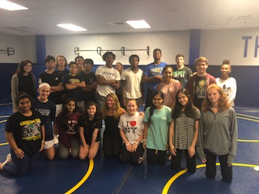
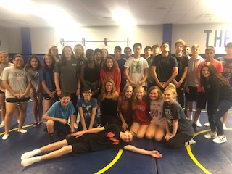
Meet Miss Ventre
Film
Sociology
World History

Slide 2
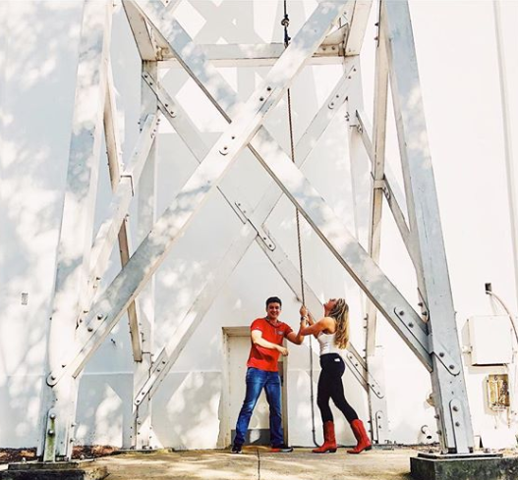
About Miss Ventre
Bachelor’s Degree in Social Studies Education & History (Go Dawgs!!)
Master’s Degree in American Studies
Teacher for 8 Years
Traveled to 32 countries on 6 continents

Slide 3
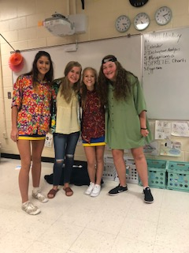
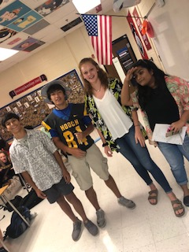
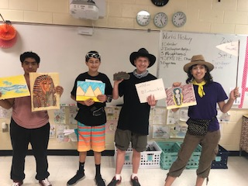
World History
Content Heavy
Activity Based
Requires more time & effort than previous years
Prep for junior year/ AP & On level
Mckeehistory.weebly.com

Slide 4
Sociology
I love being able to teach all of your kids again!
Academic Elective
Project Based Learning
Hot Topics

